Slide 1
Mod 7 - AWS Lightsail
SYS-360

Slide 2

What is Amazon Lightsail
Amazon Lightsail is the easiest way to get started with Amazon Web Services (AWS) for developers who need to build websites or web applications.
Includes what you need to launch a project quickly - instances (virtual private servers)
container services
managed databases
load balancers
SSD-based block storage,
static IP addresses, DNS management of registered domains
resource snapshots (backups)
for a predictable monthly price.

Slide 3
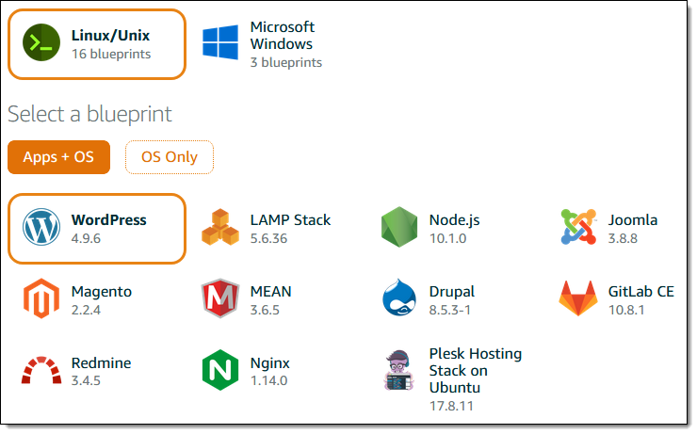
Who is Lightsail for:
Developers!
Don't have to spend as much time installing software or frameworks.
Lightsail has images with base operating systems, development stacks like LAMP, LEMP (Nginx), and SQL Server Express, and applications like WordPress, Drupal, and Magento.
Notes:
Don’t put them on the platform is the best choice, check privacy and sharing settings, remove them from the platform if possible. Impacts – embarrassment, loss of job, trouble with the law, etc.

Slide 4
Lightsail Images
Linux
Amazon Linux (2018)
Amazon Linux 2
CentOS 7 and 8
Ubuntu 16, 18, and 20
Free BSD 10
Debian 8, 9, and 10
openSUSE Leap
Windows
Windows Server 2019
Windows Server 2016
Windows Server 2012 R2
Applications:
WordPress certified by Bitnami
WordPress Multisite certified by Bitnami
cPanel & WHM
PrestaShop
Drupal certified by Bitnami
Ghost certified by Bitnami
Joomla certified by Bitnami
Plesk Hosting Stack on Ubuntu
Magento certified by Bitnami (eCommerce)
Redmine (Project Management)
Dev Platforms:
LAMP stack (PHP 7) certified by Bitnami
Node.js certified by Bitnami
MEAN Stack certified by Bitnami (HVM)
LEMP Stack (Nginx) by Bitnami
Django certified by Bitnami
GitLab certified by Bitnami (HVM)
SQL Server 2016 Express (Windows)

Slide 5
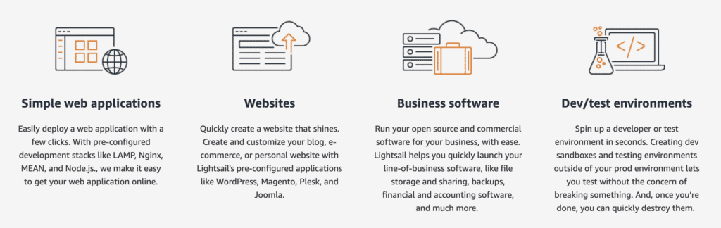
Why Lightsail?
https://aws.amazon.com/free/compute/lightsail-vs-ec2/

Slide 6
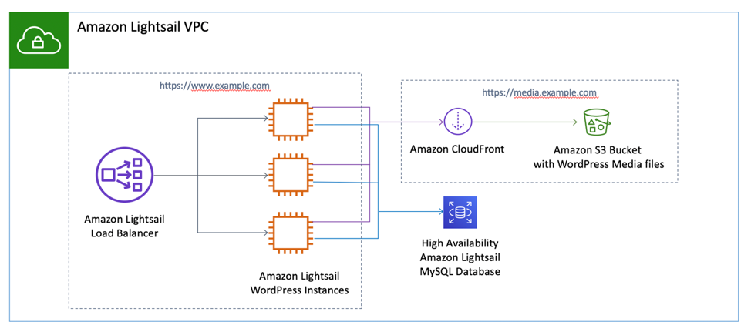
Why Lightsail?
LightSail is designed for users who do not have significant technical skills or who simply require a low cost, low-moderate performance virtual private server that they can deploy easily
Per design, it does not have the flexibility, control, or power of Amazon EC2.
Offers simple load balancing, can connect to VPC (your AWS network) and other AWS services
Easy to migrate to EC2
Can be cheaper than EC2

Slide 7
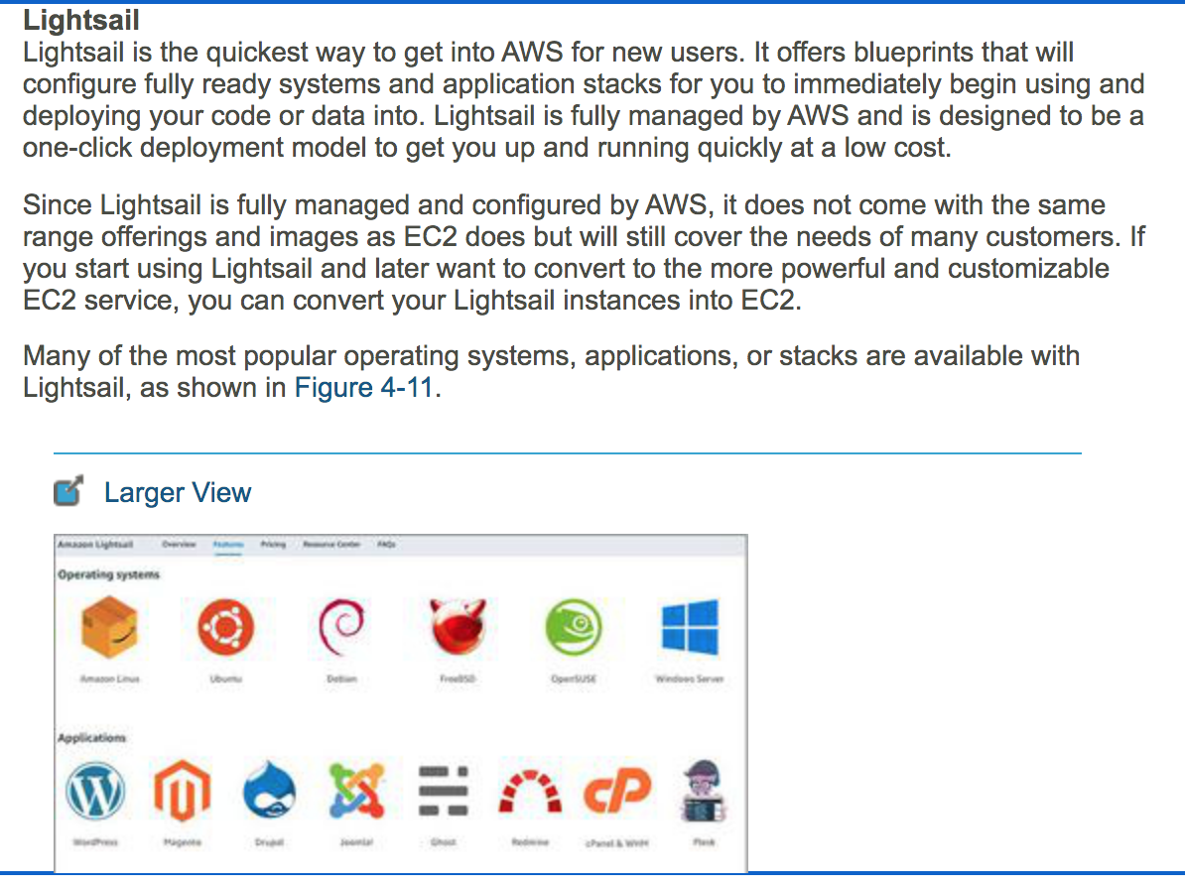
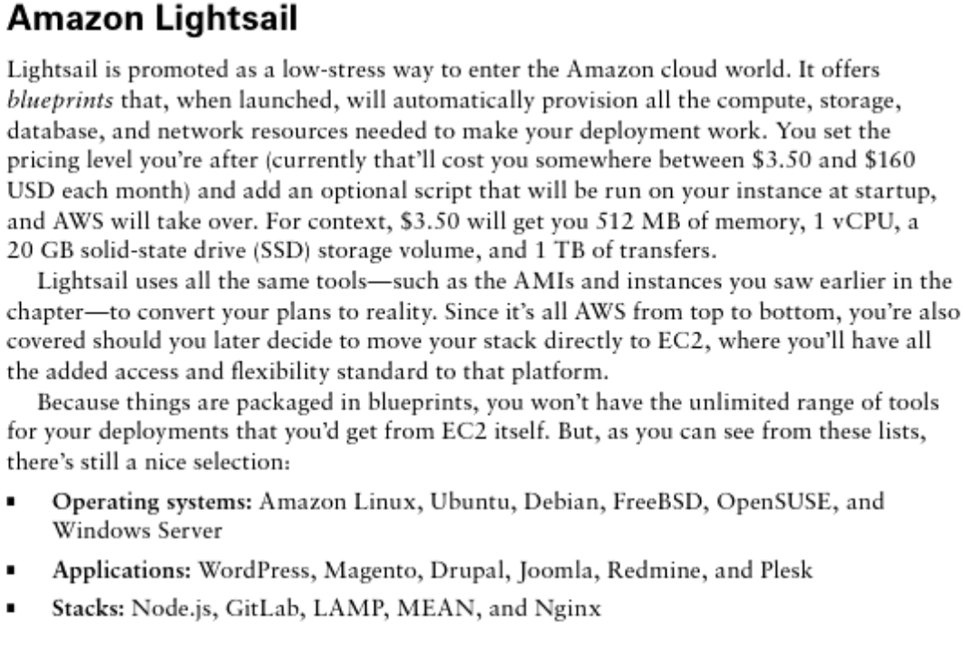
Lightsail in the AWS Cloud Practitioner Exam

